Slide 1
Why are you here?

Slide 2
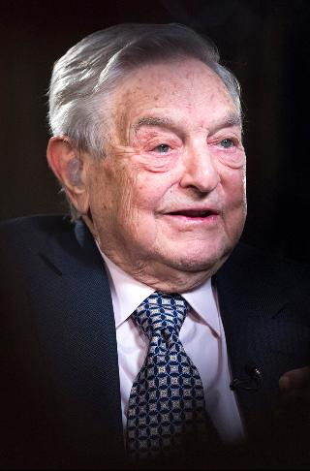
People all over the world care about the problems in Baltimore……
And they want to do something about it.

Slide 3
Use your phone to find one important fact;
George Soros, born 1930

Slide 4
George Soros: Founder of the Open Society Foundation
George Soros is the creator and funder of the Open Society Foundation (OSF), a group that seeks justice for people treated unfairly in countries around the world.
The city of Baltimore was selected for the only OSF field office in the United States in 1998.
This program was created to help all Baltimoreans become successful.
The focus of this program is to prepare you to GET and KEEP a job, now and into adulthood.

Slide 5
Staff Meetings……
As an employee, you will need to participate in staff meetings comfortably.
Restorative Circles can help us to listen, speak and act professionally.
We will call these “circles” staff meetings for the purpose of this workshop.
Have you ever participated in a circle before?

Slide 6
This is what will be required of you…
One person speaks at a time.
Try to make eye contact with EVERYONE when speaking .
Use respectful/professional language at all times.

Slide 7
Video
Baltimore's Minority Wage Gap

