Slide 1
What Job
Would You Do?

Slide 2
1

Slide 3
2

Slide 4
3

Slide 5
4

Slide 6
5

Slide 7
6

Slide 8
7

Slide 9
8

Slide 10
9

Slide 11
10

Slide 12
11

Slide 13
12

Slide 14
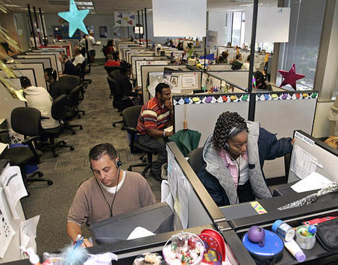
13

